Slide 1
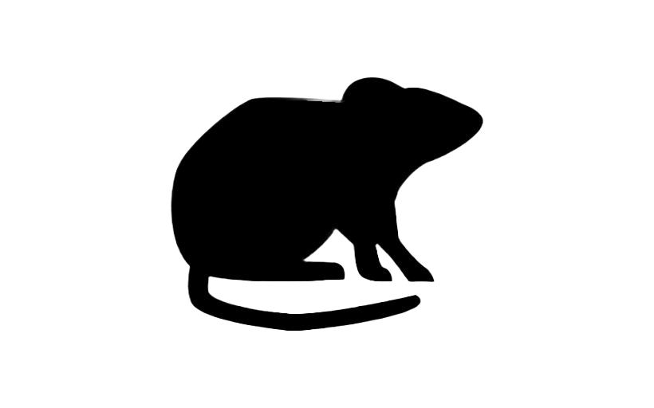
MIGHTY
RAT RUNNER

Slide 2
INTRODUCTION
2D Maze Game.
Developed using Java and Greenfoot.
Characters:
Rat
Snakes
Birds
Objective: To reach the exit without losing all the lives.
Strength: Eating the Cheese gives the Rat a Speed Boost.

Slide 3
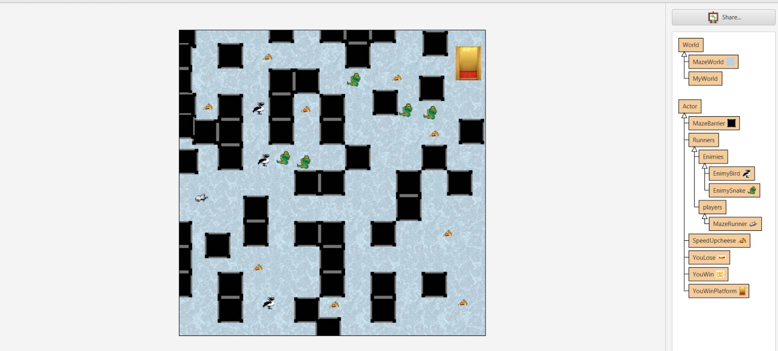
DESIGN

Slide 4
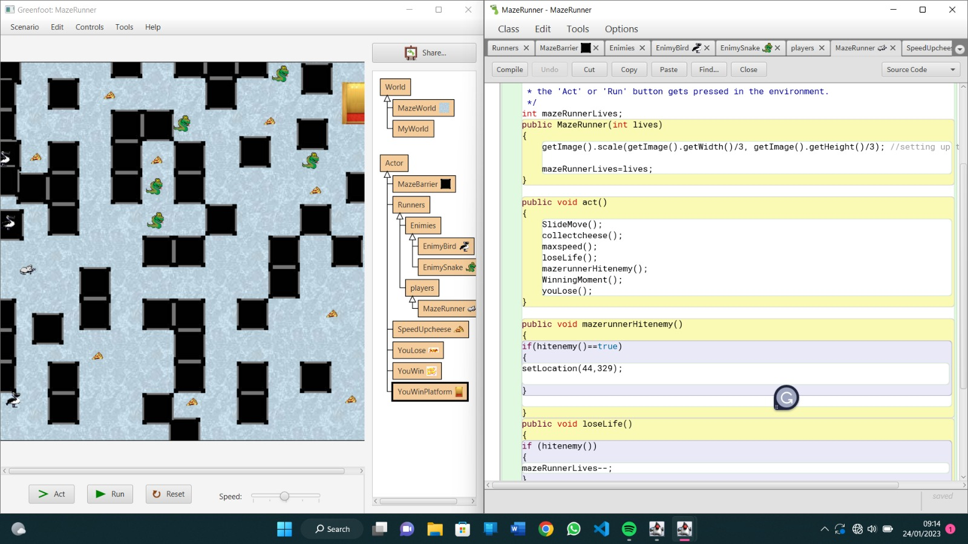
DEVELOPMENT PROCESS

Slide 5
DEMO

Slide 6
EVALUATION
Character Development
Technical Management
Use of Java Inheritance
Learning:
Use of Blueprint

Slide 7
THANK YOU
By:
Md. Junaedur Rahaman – 22102611
Mohammed Asrar Ahmed Siddiqui - 22043566

